Slide 1
Software Engineering
Topic 6: Software Implementation & Testing
Notes:
NCC Education - Title Master

Slide 2
The Unit Roadmap
Topic 1: Introduction
Topic 2: Introduction to Software Engineering Key Practices and Principles
Topic 3: Software Development Life Cycle Models
Topic 4: Requirement Engineering
Topic 5: System Modelling & Design
Topic 6: Software Implementation & Testing
Topic 7: System Dependency & Security
Topic 8: Project Management
Topic 9: Mini Project 1
Topic 10: Mini Project 2
Topic 11: Mini Project 3
Topic 12: Mini Project 4

Slide 3
Recap on Topic 5
System modelling is the process of developing abstract models of system, with each model presenting a different view or perspective of the system. In which cycles of SDLC system modeming is used?
UML Diagrams include use case, activity, state, sequential, class diagrams and are useful tools for system modelling. What are the objectives of each of these diagrams?
Object-oriented design includes design of object classes and their relationship. How to construct an object in a system?
Design patterns are reusable solutions for common problems in software development. What are main components of a design pattern?

Slide 4
Scope and Coverage
This topic will cover:
Software Implementation Issues
Software Reuse
Configuration Management
Open-source Development
Validation, Verification and Testing
Development testing
Test driven development
Test Techniques
Release testing
User Testing
Notes:
NCC Education - Slide Master

Slide 5
Learning Outcomes
By the end of this topic students will be able to:
Discuss the role of system implementation , testing and maintenance in software engineering.
Explain methods and techniques for software testing and change management.

Slide 6
Software Design & Implementation
Software Implementation
Refers to the process of designing, coding, testing, and deploying software applications to a specific target environment.
This process involves transforming the design and architecture of a software system into a functioning and fully operational software system.
Implementation: realising the design as a program.

Slide 7
Implementation Issues
Focus here is not on programming, although this is obviously important, but on other implementation issues that are often not covered in programming texts:
Reuse: Most modern software is constructed by reusing existing components or systems. When you are developing software, you should make as much use as possible of existing code.
Configuration Management: During the development process, you have to keep track of the many different versions of each software component in a configuration management system.
Host-target Development: Production software does not usually execute on the same computer as the software development environment. Rather, you develop it on one computer (the host system) and execute it on a separate computer (the target system).

Slide 8
Reuse
From 1960s to 1990s, most new software was developed from scratch, by writing all code in a high-level programming language.
The only significant reuse or software was the reuse of functions and objects in programming language libraries.
Costs and schedule pressure mean that this approach became increasingly unviable, especially for commercial and Internet-based systems.
An approach to development based around the reuse of existing software emerged and is now generally used for business and scientific software.

Slide 9
Software Reuse
Re-use based software engineering
A strategy in which the development process is geared to reusing existing software.
A response to the demand for fast software delivery and increased software quality.
The open-source movement means there are massive amount of code available.
It can be in form of program libraries or the whole application.

Slide 10
Short Activity
Divide the class into two groups:
First group identify the advantages of software reuse
Second group to identify issues and challenges of software reuse
Both groups to discuss their findings at the end.

Slide 11
Reuse Levels
The abstraction level
At this level, you don’t reuse software directly but use knowledge of successful abstractions in the design of your software.
The object level
At this level, you directly reuse objects from a library rather than writing the code yourself.
The component level
Components are collections of objects and object classes that you reuse in application systems.
The system level
At this level, you reuse entire application systems.

Slide 12
Reuse Components
Component
Reuse Objective
system reuse
application reuse
component reuse
object and function reuse
Multiple applications (quick development needed)
Configuring an application for different clients (ranging in size from sub-systems to single objects)
Implement a single function

Slide 13
Reuse Example
Most widely reused application framework is Web Application Framework (WAF).
The architecture of WAF are based on Model-View-Controller (MVC) pattern.
WAF reusable functions and components:
Security
Dynamic web pages
Database integrator
Session manager
User interaction

Slide 14
Reuse Cost
Time spent looking for software to reuse and assessing whether or not it meets your needs.
Adapting and configuring the reusable software components or systems to reflect the requirements of the system that you are developing.
Integrating reusable software elements with each other (if you are using software from different sources) and with the new code that you have developed.
Where applicable, the costs of buying the reusable software. For large off-the-shelf systems, these costs can be very high.

Slide 15
Configuration Management
The general process of managing a changing software system.
Aim
To support system integration process so that all developers can access the project code and documents in a controlled way, find out what changes have been made, and compile and link components to create a system.

Slide 16
Configuration Management Activities
Version management,
support to keep track of the different versions of software components.
include facilities to coordinate development by several programmers.
System integration,
support to help developers define what versions of components are used to create each version of a system.
Used to build a system automatically by compiling and linking the required components.
Problem tracking,
support to allow users to report bugs and other problems,
allow all developers to see who is working on these problems and when they are fixed.

Slide 17
Development Platform Tools
Integrated compiler and syntax-directed editing system that allows you to create, edit and compile code.
A language debugging system.
Graphical editing tools, such as tools to edit UML models.
Testing tools, such as Junit that can automatically run a set of tests on a new version of a program.
Project support tools that help you organise the code for different development projects.

Slide 18
Integrated Development Environments (IDEs)
Software development tools are often grouped to create an integrated development environment (IDE).
An IDE is a set of software tools that supports different aspects of software development, within some common framework and user interface.
IDEs are created to support development in a specific programming language such as Java.
The language IDE may be developed specially, or may be an instantiation of a general-purpose IDE, with specific language-support tools.

Slide 19
Short Activity
Provide examples of Integrated Development Environments (IDEs) that you are familiar with or have experience using.

Slide 20
Open-Source Development
An approach to software development in which the source code of a software system is published and volunteers are invited to participate in the development process.
Roots in the Free Software Foundation (www.fsf.org).
Advocates source code should not be proprietary but should always be available for users to examine and modify as they wish.
Open-source software extended this idea by using the Internet to recruit a much larger population of volunteer developers. Many of them are also users of the code.
See: https://www.codemotion.com/magazine/infographics/the-history-of-open-source/

Slide 21
Open-Source Systems
Best-known open-source product is Linux operating system
widely used as a server system and increasingly, as a desktop environment.
Other important open-source products are:
Java,
Apache web server
MySQL database management system.

Slide 22
Open-Source Licensing
Fundamental principle is that source code should be freely available, BUT this does not mean that anyone can do as they wish with that code.
Legally, the developer of the code (company or individual) still owns the code. They can place restrictions on how it is used by including legally binding conditions in an open-source software license.
Some open-source developers believe that if an open-source component is used to develop a new system, then that system should also be open source.
Others are willing to allow their code to be used without this restriction. The developed systems may be proprietary and sold as closed source systems.

Slide 23
Short Activity
Provide examples of automated tool in software development.
Prepare a list of tools and the correspondence SDLC process for each tool (except for the testing stage).

Slide 24
Checkpoint Summary
Software implementation Refers to the process of designing, coding, testing, and deploying software applications to a specific target environment.
Software reuse is a strategy in which the development process is geared to reusing existing software.
Software reuse has 4 levels of:
system reuse
application reuse
component reuse
object and function reuse
An IDE is a set of software tools that supports different aspects of software development, within some common framework and user interface.

Slide 25
Program Testing
Testing is intended to show that a program does what it is intended to do and to discover program defects before it is put into use.
Execute a program using artificial data.
Check the results of the test run for errors, anomalies or information about the program’s non-functional attributes.
Can reveal the presence of errors NOT their absence.
Part of a more general verification and validation process, which also includes static validation techniques.

Slide 26
Program Testing Goals
To demonstrate to the developer and the customer that the software meets its requirements.
For custom software, at least one test for every requirement in the requirements document.
For generic software products, tests for all of the system features, plus combinations of these features, that will be incorporated in the product release.
To discover situations in which the behaviour of the software is incorrect, undesirable or does not conform to its specification.
Defect testing is concerned with rooting out undesirable system behaviour such as system crashes, unwanted interactions with other systems, incorrect computations and data corruption.

Slide 27
Testing Process Goals
Validation testing
To demonstrate to the developer and the system customer that the software meets its requirements
A successful test shows that the system operates as intended.
Defect testing
To discover faults or defects in the software where its behaviour is incorrect or not in conformance with its specification.
A successful test is a test that makes the system perform incorrectly and so exposes a defect in the system.

Slide 28
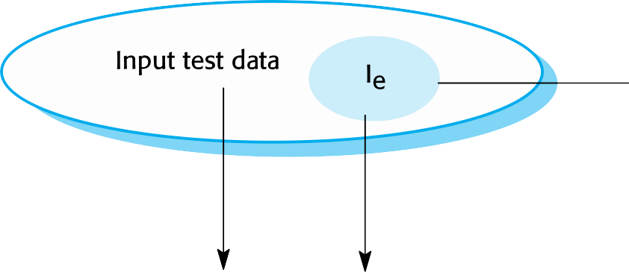

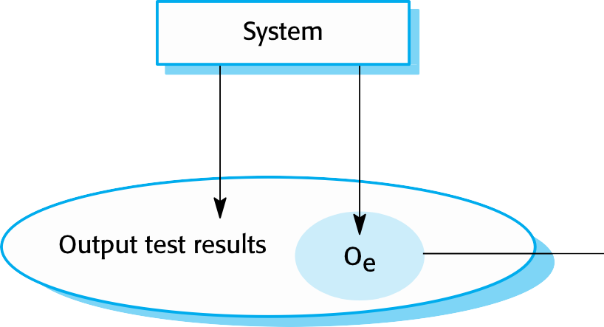
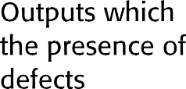
An Input-output Model Of Program Testing
Sommerville, I. (2016)

Slide 29
Verification Vs Validation
Verification:
"Are we building the product right”.
The software should conform to its specification.
Validation:
"Are we building the right product”.
The software should do what the user really requires.

Slide 30
Inspection And Testing
Software inspections:
Concerned with analysis of the static system representation to discover problems (static verification).
May be supplement by tool-based document and code analysis.
Software testing:
Concerned with exercising and observing product behaviour (dynamic verification).
The system is executed with test data and its operational behaviour is observed.

Slide 31

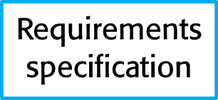
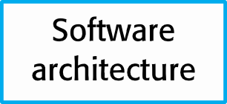

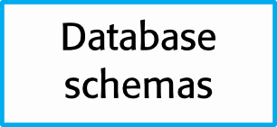

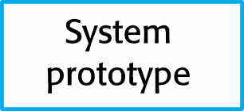

Inspections and Testing
Sommerville, I. (2016)

Slide 32
Stages Of Testing
Development testing,
the system is tested during development to discover bugs and defects.
Release testing,
a separate testing team test a complete version of the system before it is released to users.
User testing,
where users or potential users of a system test the system in their own environment.

Slide 33
Development Testing
Includes all testing activities that are carried out by the team developing the system.
Unit testing,
individual program units or object classes are tested. Unit testing should focus on testing the functionality of objects or methods.
Component testing,
several individual units are integrated to create composite components. Component testing should focus on testing component interfaces.
System testing,
all of the components in a system are integrated and the system is tested as a whole. System testing should focus on testing component interactions.

Slide 34
Unit Testing
The process of testing individual components in isolation.
It is a defect testing process.
Units may be:
Individual functions or methods within an object.
Object classes with several attributes and methods.
Composite components with defined interfaces used to access their functionality.

Slide 35
Object Class Testing
Complete test coverage of a class involves:
Testing all operations associated with an object
Setting and interrogating all object attributes
Exercising the object in all possible states.
Inheritance makes it more difficult to design object class tests as the information to be tested is not localised.

Slide 36













The Weather Station Object Interface
Sommerville, I. (2016)

Slide 37
Short Activity
You are tasked with testing the interface of a WeatherStation class in a weather monitoring application.
Explain at least tests on 2 methods of this class.

Slide 38
Automated Testing
Whenever possible, unit testing should be automated so that tests are run and checked without manual intervention.
Use a test automation framework (such as JUnit) to write and run your program tests.
Unit testing frameworks provide generic test classes that you extend to create specific test cases.
Run all of the tests that you have implemented and report, often through some GUI, on the success of otherwise of the tests.

Slide 39
Test-driven Development (TDD)
An approach to program development with inter-leave testing and code development.
Tests are written before code and ‘passing’ the tests is the critical driver of development.
Develop code incrementally, along with a test for that increment. You don’t move on to the next increment until the code that you have developed passes its test.
Introduced as part of agile methods such as Extreme Programming. However, it can also be used in plan-driven development processes.

Slide 40
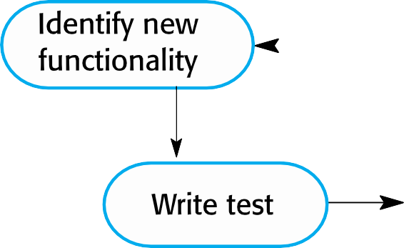

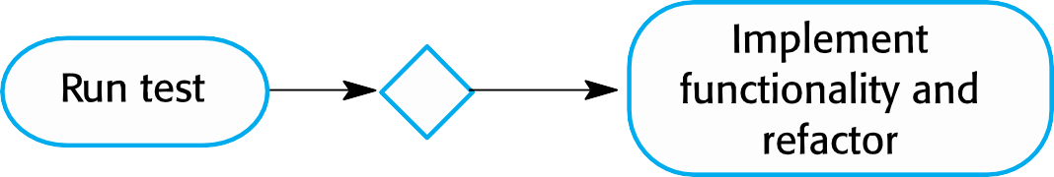
Test-driven Development
Sommerville, I. (2016)

Slide 41
TDD Process Activities
Start by identifying the increment of functionality that is required. This should normally be small and implementable in a few lines of code.
Write a test for this functionality and implement this as an automated test.
Run the test, along with all other tests that have been implemented. Initially, you have not implemented the functionality so the new test will fail.
Implement the functionality and re-run the test.
Once all tests run successfully, you move on to implementing the next chunk of functionality.

Slide 42
Release Testing
The process of testing a particular release of a system that is intended for use outside of the development team.
Goal of release testing process is to convince the supplier of the system that it is good enough for use.
Must show that the system delivers its specified functionality, performance and dependability, and that it does not fail during normal use.
Not carried out by development team
Release testing is usually a black-box testing process where tests are only derived from the system specification.

Slide 43
Requirements Based Testing
Involves examining each requirement and developing a test or tests for it.
E.g.: Mental Health Support system requirements:
If a patient is known to be allergic to any particular medication, then prescription of that medication shall result in a warning message being issued to the system user.
If a prescriber chooses to ignore an allergy warning, they shall provide a reason why this has been ignored.
Exercise: What tests should be developed?

Slide 44
Performance Testing
Part of release testing may involve testing the emergent properties of a system, such as performance and reliability.
Tests should reflect the profile of use of the system.
Performance tests usually involve planning a series of tests where the load is steadily increased until the system performance becomes unacceptable.
Stress testing is a form of performance testing where the system is deliberately overloaded to test its failure behaviour.

Slide 45
User Testing
User or customer testing is a stage in the testing process in which users or customers provide input and advice on system testing.
User testing is essential, even when comprehensive system and release testing have been carried out.
The reason for this is that influences from the user’s working environment have a major effect on the reliability, performance, usability and robustness of a system. These cannot be replicated in a testing environment.

Slide 46
Types Of User Testing
Alpha testing
Users of the software work with the development team to test the software at the developer’s site.
Beta testing
A release of the software is made available to users to allow them to experiment and to raise problems that they discover with the system developers.
Acceptance testing
Customers test a system to decide whether or not it is ready to be accepted from the system developers and deployed in the customer environment. Primarily for custom systems.

Slide 47
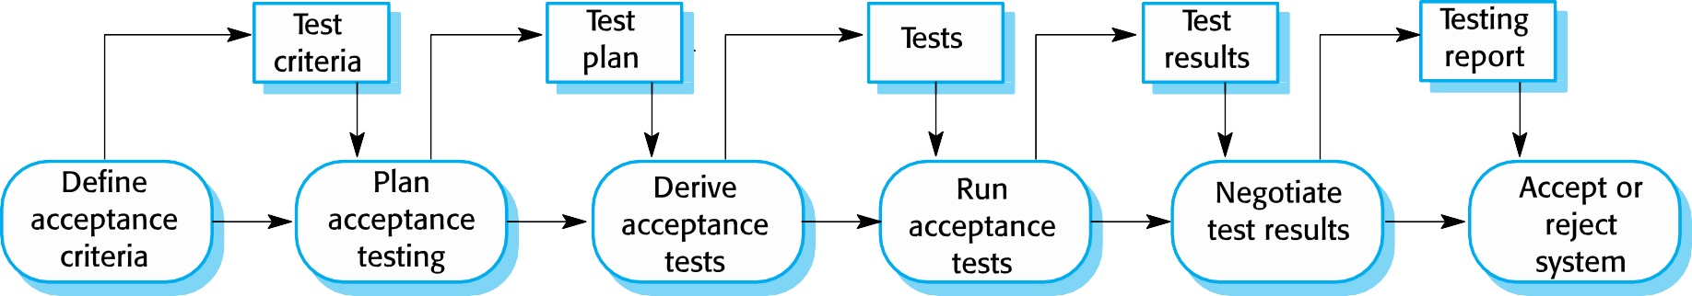
The Acceptance Testing Process
Sommerville, I. (2016)

Slide 48
Agile Methods And Acceptance Testing
User/customer is part of the development team and responsible for making decisions on the acceptability of the system.
Tests are defined by the user/customer and are integrated with other tests in that they are run automatically when changes are made.
No separate acceptance testing process.
Main problem here is whether or not the embedded user is ‘typical’ and can represent the interests of all system stakeholders.

Slide 49
Topic Summary
When developing software, you should always consider the possibility of reusing existing software, either as components, services or complete systems.
Configuration management is the process of managing changes to an evolving software system. It is essential when a team of people are cooperating to develop software.
Most software development is host-target development. You use an IDE on a host machine to develop the software, which is transferred to a target machine for execution.
Open-source development involves making the source code of a system publicly available. This means that many people can propose changes and improvements to the software.

Slide 50
Topic Summary
Testing can only show the presence of errors in a program. It cannot demonstrate that there are no remaining faults.
Development testing is the responsibility of the software development team. A separate team should be responsible for testing a system before it is released to customers.
Development testing includes unit testing, in which you test individual objects and methods component testing in which you test related groups of objects and system testing, in which you test partial or complete systems.

Slide 51
Topic Summary
When testing software, you should try to ‘break’ the software by using experience and guidelines to choose types of test case that have been effective in discovering defects in other systems.
Wherever possible, you should write automated tests. The tests are embedded in a program that can be run every time a change is made to a system.
Test-first development is an approach to development where tests are written before the code to be tested.
Scenario testing involves inventing a typical usage scenario and using this to derive test cases.
Acceptance testing is a user testing process where the aim is to decide if the software is good enough to be deployed and used in its operational environment.

Slide 52
Quiz
False or True:
The main goal of software reuse is speedy delivery
IDE stands for integrated development environment
In accordance with open-source licensing, anyone can do whatever with the open-source codes.
Release testing is done inside the development team
Fill the gaps:
Software Implementation refers to the process of -------, --------, --------, and ------------- software applications to a specific target environment.
in ------- level of reuse we do not reuse the software, but the knowledge.
----------------- is about managing a changing software system.

Slide 53
Private Study
Research software automated testing:
List examples
Explain which testing abstract level they are working in.

Slide 54
The Unit Roadmap
Topic 1: Introduction
Topic 2: Introduction to Software Engineering Key Practices and Principles
Topic 3: Software Development Life Cycle Models
Topic 4: Requirement Engineering
Topic 5: System Modelling & Design
Topic 6: Software Implementation & Testing
Topic 7: System Dependency & Security
Topic 8: Project Management
Topic 9: Mini Project 1
Topic 10: Mini Project 2
Topic 11: Mini Project 3
Topic 12: Mini Project 4

Slide 55
References
Sommerville, I. (2016), Software Engineering, 10th edition. Pearson

Slide 56
Topic 6 – Software Implementation & Testing
Any Questions?
Notes:
NCC Education - End Slide Master

